Slide 1
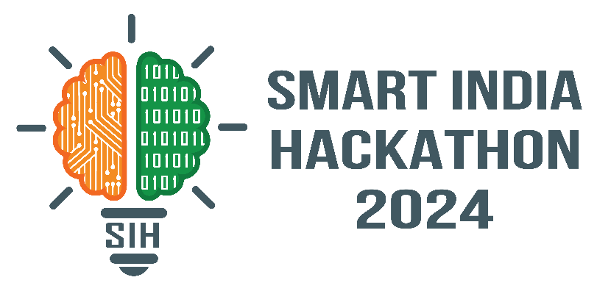

SMART INDIA HACKATHON 2024
TITLE PAGE
Problem Statement ID –1689
Problem Statement Title-Use of Digital Technology to calculate Water Footprint for different Agricultural Products.
Theme-Clean & Green Technology
PS Category- Software
Team ID-
Team Name (Registered on portal):HydroHackers

Slide 2

HYDROHACKERS
Unique Value Proposition:
A chatbot for assisting general users & farmers not only in obtaining a numerical value of water footprint but also in receiving tailored suggestions based on their individual needs.
Solution:
Intuitive Interface: Easy-to-use platform that uncovers the water costs behind edible items.
Search Magic: Type the product name or snap a picture instantly discover its water footprint.
Multilinguality: Instead of general-purpose translation tools, utilizing Bhasini ensuring more contextually accurate Indian translations.
Precision: Leveraging Neural Network to create the Model which fits for the Problem Statement
WHY→Addressing the core issue AI driven(accurate) Water Footprint
Accurate Water Footprint
Website
Forecast future trends
Deliver personalized suggestions
Chatbot support
@SIH Idea submission- Template

Slide 3
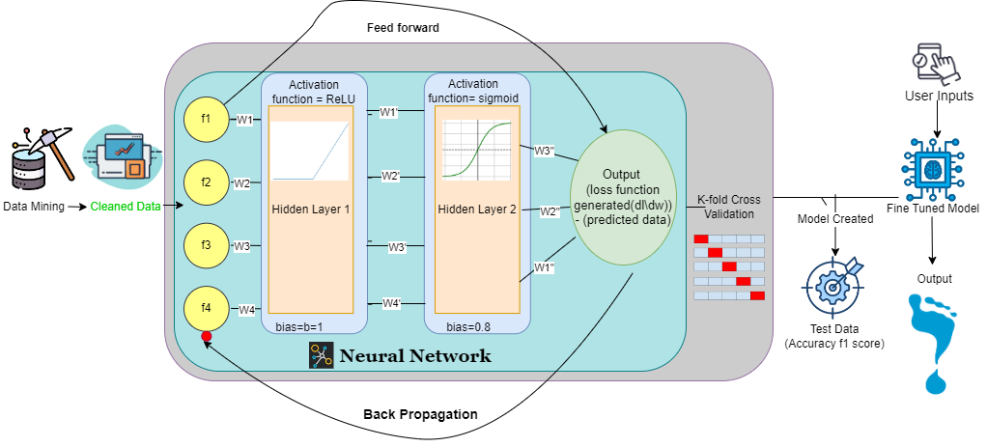
TECHNICAL APPROACH
HYDROHACKERS
Tech Stacks
Website Development
JavaScript->React.JS
Django-For Scalability and Security
Flask-To minimize latency
Encryption & Security
Blockchain-Solidity to ensure cross-platform compatibility
*Note: Inserted single line b/w function and hidden layers to avoid complexity
f1,f2….fn are ML feature input like soil ,rainfall, land area, etc.
Diagram to comprehend the process of creation of our AI model
@SIH Idea submission- Template

Slide 4
FEASIBILITY AND VIABILITY
HYDROHACKERS
Feasibility of the idea
Technical Feasibility:
-Used neural networks in ML to check and train multiple feature influence weightage for water footprint calculation .
Financial Feasibility:
-Develop & license our API for other apps.
-Premium model.
-Utilize open-source tools.
Market Feasibility:
-Local languages ensure PAN India usage.
-Simple &Minimalistic UI: Ensuring it’s effortless for users to learn and explore the Website.
Potential Challenges
-Water footprint data might change due to unforeseen circumstances.
-Implementing our solution at a large scale could be challenging & inaccurate.
Strategies for overcoming these challenges
-Improving our ML algorithm & diversifying the datasets to adapt to sudden changes.
-Utilize cloud computing platform with scalable infrastructure to manage large data volumes and user traffic.
@SIH Idea submission- Template

Slide 5
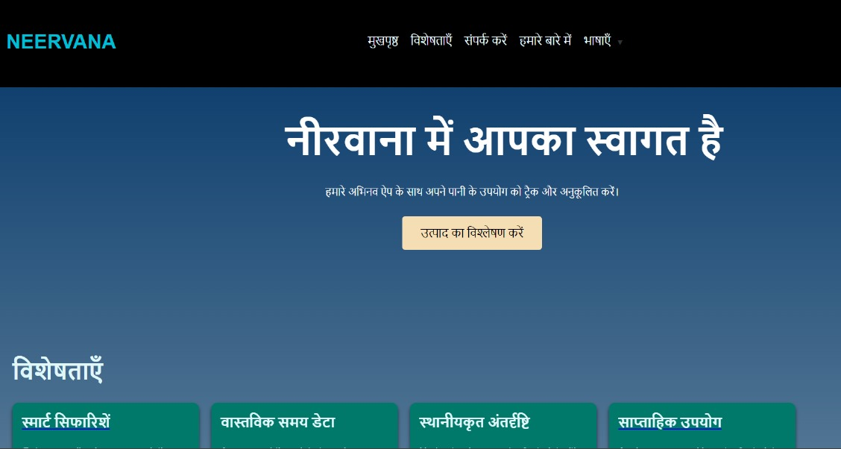
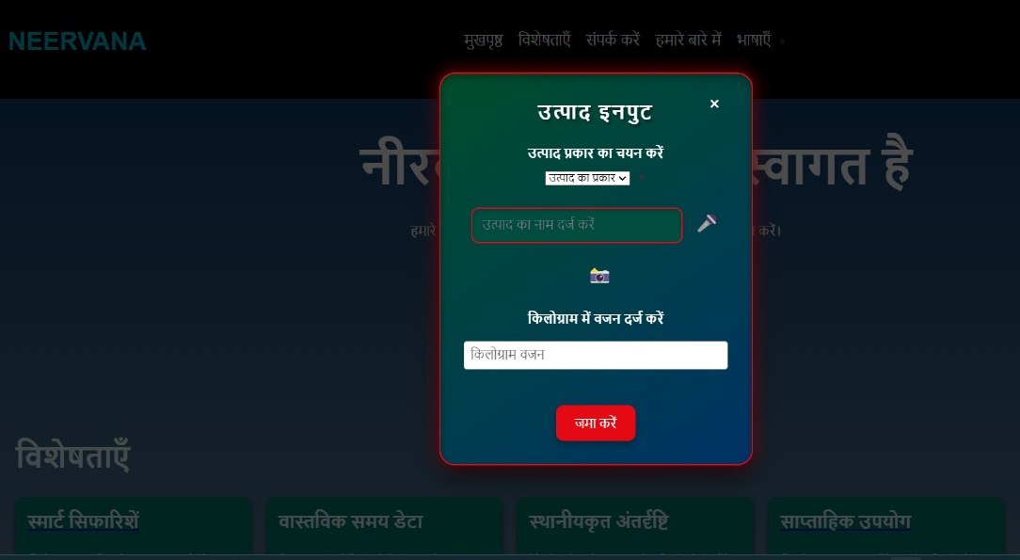

IMPACT AND BENEFITS
HYDROHACKERS
-Identifies ways to lower water usage and associated costs.
-Farmers/cultivators would be ready with any new information on footprints if it changes drastically during natural/political calamities.
Prototype
@SIH Idea submission- Template

Slide 6
RESEARCH AND REFERENCES
HYDROHACKERS
Bibliography
Datasets used:
https://data.4tu.nl/datasets/7b45bcc6-686b-404d-a910-13c87156716a
@SIH Idea submission- Template

